Slide 1
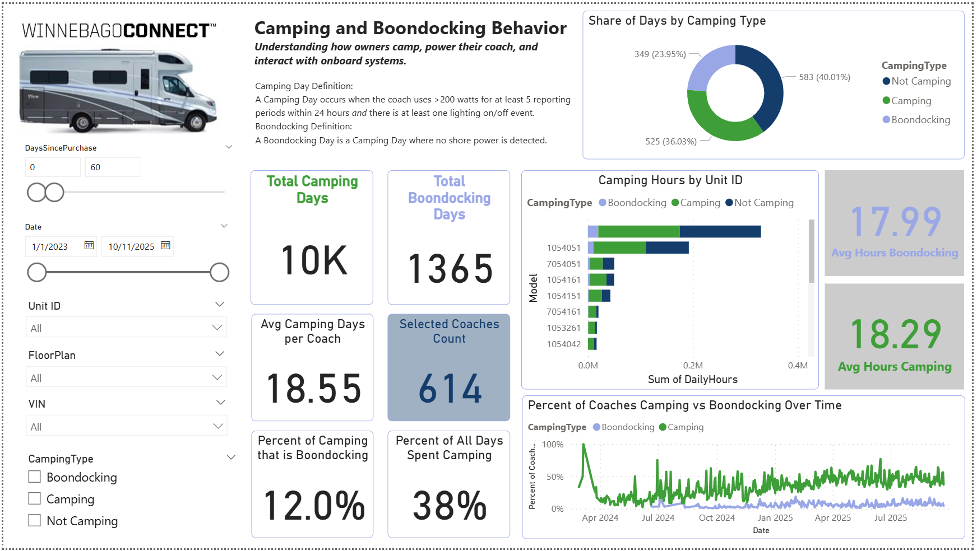
1. Objective
Winnebago Connect
Group 2
Anne, Jack, Emily, Mckenzie
4. Data Description
6. Business Recommendation
The objective of this project is to analyze and visualize customer usage from Winnebago Connect™, a connected coach system launched in January 2024 with the refreshed View/Navion series. Winnebago Connect™ provides WMH with a proprietary stream of data showing how owners camp, travel, and interact with their motorhomes.
These insights help WMH understand whether customers are realizing the intended benefits of Winnebago Connect™, identify underused features, and uncover opportunities for product and service improvements. As these findings scale across additional motorhome series, they can support greater customer satisfaction, stronger adoption of premium services, and continued leadership in connected RV technology.
The datasets provided by Winnebago include thousands of daily records across telemetry, GPS, alerts, and command activity. Outliers such as extreme GPS jumps or anomalous power spikes were removed to improve accuracy. The median and mean values of camping days, travel distances, and power usage have remained consistent across VINs, providing a reliable foundation for customer behavior analysis.
Enhance Customer Experience → Use camping and boondocking insights to tailor service packages (e.g., off‑grid support for frequent boondockers).
Optimize Product Design → Incorporate generator and power usage trends into future motorhome models to improve efficiency.
Targeted Feature Development → Expand adoption of underused features (e.g., Pet Minder, awning controls) through education and marketing.
Proactive Maintenance → Leverage alert patterns to identify common issues and reduce service costs with preventive solutions.
Data‑Driven Marketing → Segment customers by travel and camping behavior to personalize promotions and loyalty programs.
Continuous Improvement → Use dashboard feedback loops to refine metrics and ensure alignment with evolving customer needs.
Raw Excel Datasets:
Telementry
Geo
Alerts
Requests
VIN/Owner
Date
PowerBI Dashboard
Camping
Travel
Power
Alerts
Commands
Data Cleaning and Aggregation:
Outlier remove
Daily Rollups
2. Assumptions and Challenges
Assumptions
VIN and Date fields serve as reliable keys to connect all datasets.
Telemetry data (power, lighting, HVAC, generator) accurately reflects daily coach activity.
GPS changes greater than 5 miles are a proxy for identifying travel days.
Lighting activity is a dependable indicator of occupancy/camping
Challenges
Complex joins across VINs risked misreporting and double counting; solved with consistent VIN/Date keys.
Precision in calculations was critical to build trust with stakeholders; addressed through iterative DAX testing and validation.
Classification accuracy for camping vs. boondocking required clear rules and sponsor feedback to avoid misleading insights.
Dashboard clarity demanded balancing technical depth with intuitive visuals, ensuring non‑technical users could interpret results.
Collaboration hurdles arose from multiple datasets and evolving requirements; managed through agile refinement and frequent reviews with the Winnebago team.
5. Sample Deliverables
Important Variables
VIN & Date Keys
VIN and Date fields serve as the primary connectors across telemetry, GPS, alerts, and command tables. This ensures accurate aggregation of daily usage patterns and prevents misreporting across vehicles.
Camping Classification Logic
Daily activity is categorized into Camping, Boondocking, or Not Camping using power thresholds, lighting activity, and shore power detection. This logic aligns with Winnebago’s specifications for customer behavior.
Power Source Rollup
Shore, solar, generator, and alternator watts are combined into a single measure of total power. This unified metric enables consistent comparisons of energy usage across different camping types.
Pet Minder Data
Alerts related to RV temperature comfort are flagged as Pet Minder events. These records allow analysis of how often the feature is enabled, its duration, and its relationship to camping and travel conditions.
3. Methodology
Power BI was chosen as the primary tool for data cleaning, modeling, and visualization. The datasets provided by WMH in Excel format were imported and connected using VIN and Date as key relationships. We created calculated columns and measures to classify camping and travel behavior, aggregate power consumption, and track feature usage. Logic was implemented through DAX formulas to unify lighting activity, combine power sources, and build daily summary tables. These measures feed into interactive dashboard pages that display camping, boondocking, travel, power, alerts, and command usage trends.

